Slide 1

Census Population Segmentation for each County in the United States.
Supervisor:
Dr. Sean Mondesire
Assistant Professor
Program Director
Computer Science
St. Thomas University.

Slide 2
GROUP MEMBERS
Camilo Alejandro Riviere
Syed Shaheryar Qadir
Juan Ruiz

Slide 3
CONTENTS
Problem Statement
Project Objective
Purpose and Motivation
Variable Description
Phase – I : Acquiring and Cleaning Data
Acquiring Data
Tidying Procedure

Slide 4
CONTENTS
Phase – II : Modeling
Visualizing the Data
Data Scaling
PCA Model
Population Segmentation
K-Means Centroids
Heatmap of Centroids
Labeling the Centroids
Conclusion
References

Slide 5
PROBLEM STATEMENT
PROBLEM STATEMENT

Slide 6
PROBLEM STATEMENT
Problem Statement
How can clustering be applied to better understand the voters for each county?

Slide 7
PROJECT OBJECTIVES
PROJECT OBJECTIVES

Slide 8
PROJECT OBJECTIVE
Project Objective
The goal is to gain a better understanding of the voters in the United States. This project explores how we can apply unsupervised clustering to better integrate science into the task of identifying the voters which are more likely to vote for either Republican or Democrat.

Slide 9
PURPOSE AND MOTIVATION
PURPOSE AND MOTIVATION

Slide 10
PURPOSE AND MOTIVATION
Purpose and Motivation
The outcome of this analysis are natural groupings of similar counties in a transformed feature space. The cluster that a county belongs to can be leveraged to plan an election campaign, for example, to understand how to reach a group of similar counties by highlighting messages that resonate with that group. More generally, this technique can be applied by businesses in customer or user segmentation to create targeted marketing campaigns.

Slide 11
VARIABLE DESCRIPTION
Variable Description

Slide 12
INDEPENDENT VARIABLES
Total Population
Men
Women
Citizenship
Employment
Private worker
Public worker
Self Employed
Unemployed
Race
White
Hispanic
Black
Asian
Pacific
Native

Slide 13
DEPENDENT VARIABLES
County

Slide 14
PHASE – I
PHASE – I : ACQUIRING AND CLEANING DATA

Slide 15
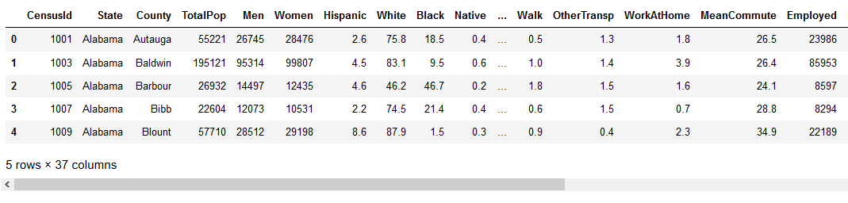
PHASE – I : ACQUIRING DATA

Slide 16
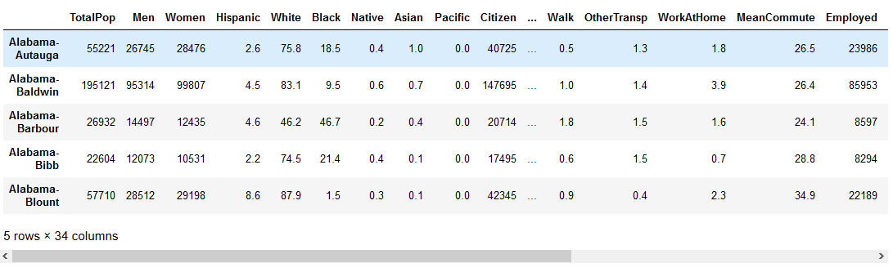
PHASE – I : TIDYING PROCEDURE
Tidying Procedure
“State” & “Census ID” were deleted, since state-county is the main focus. For which we assigned “State-County” as the index.

Slide 17
PHASE – II
PHASE – II : MODELING

Slide 18
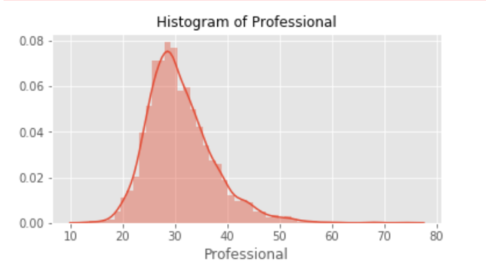
PHASE – II : VISUALIZING THE DATA

Slide 19
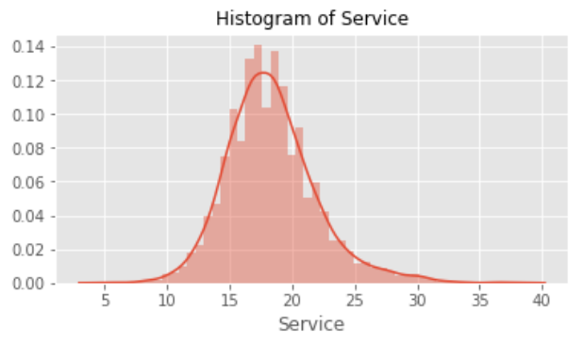
PHASE – II : VISUALIZING THE DATA

Slide 20
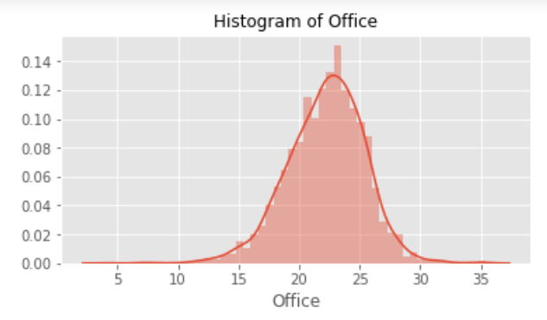
PHASE – II : VISUALIZING THE DATA

Slide 21
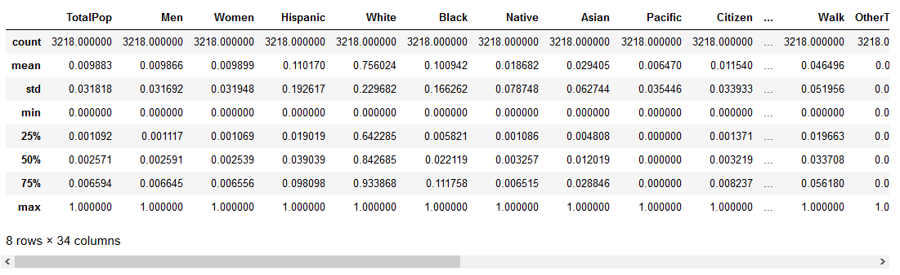
PHASE – II : DATA SCALING
In order to standardize the scaling of the numerical columns to use any distance based analytical methods so that we can compare the relative distances between different feature columns. We used minmaxscaler to transform the numerical columns so that they also fall between 0 and 1..

Slide 22
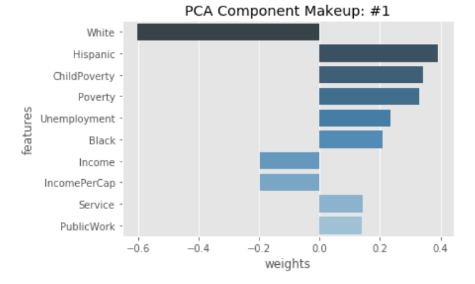
PHASE – II : PCA MODEL

Slide 23
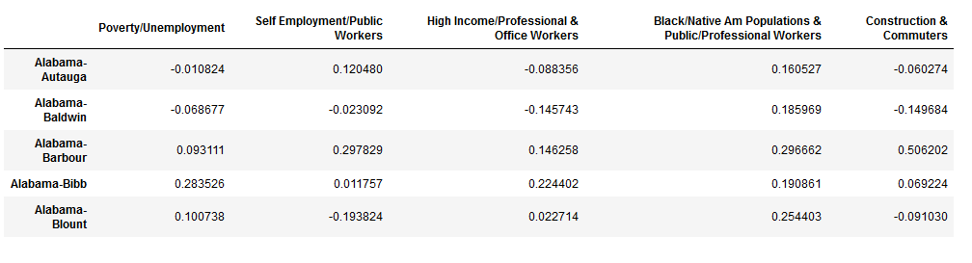
PHASE – II : PCA MODEL

Slide 24
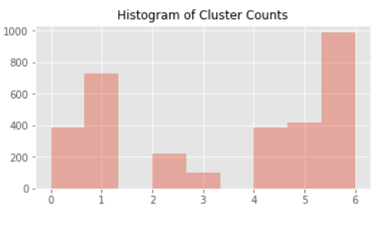
PHASE – II : POPULATION SEGMENTATION
(Done on Training Set)

Slide 25
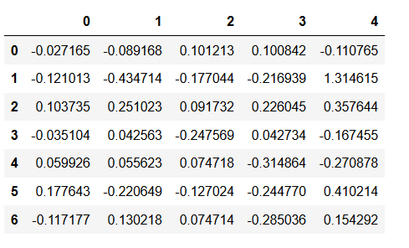
PHASE – II : K-MEANS CENTROIDS

Slide 26
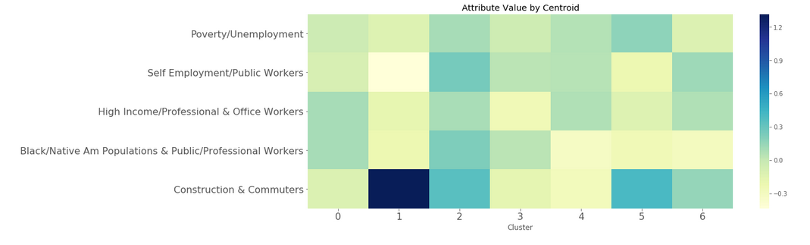
PHASE – II : HEATMAP OF CENTROIDS

Slide 27
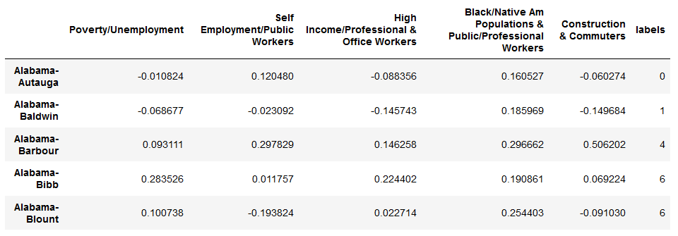
PHASE – II : LABELING THE CLUSTERS

Slide 28
PHASE – I & II
CONCLUSION

Slide 29
REFERENCES
https://factfinder.census.gov/faces/nav/jsf/pages/index.xhtml

Slide 30


